Slide 1
Chapter Five
Introduction to Computer Networks

Slide 2
Contents
Basics of Data Communication
Data Transmission
Communication Mode
Computer Networks and Its Application
Types of Networks
Network Models and Topologies
Transmission Media
The Internet and Web Concept

Slide 3
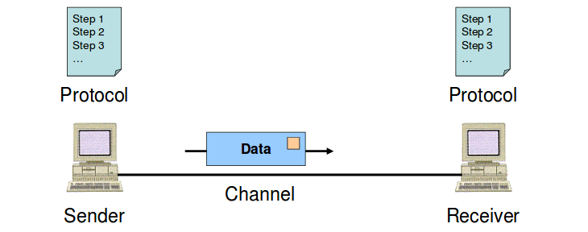
Basics of Data communication
The term telecommunication means communication at a distance
The word data refers to information presented in whatever form is agreed upon by the parties creating and using the data
Data communications are the exchange of data between two devices via some form of transmission medium such as a wire cable.

Slide 4
Basics of Data communication (Cont.)
The effectiveness of a data communication system depends on four fundamental characteristics:
1. Delivery: The system must deliver data to the correct destination.
Data must be received by the intended device or user and only by that device or user.
2. Accuracy: The system must deliver the data accurately.

Slide 5
Basics of Data communication (Cont.)
3. Timeliness: The system must deliver data in a timely manner.
Data delivered late are useless.
Jitter: Jitter refers to the variation in the packet arrival time.
It is an uneven delay in the delivery of audio or video packets.
Example: For example, let us assume that video packets are sent every 30 ms. If some of the packets arrive with 30-ms delay and others with 40-ms delay, an uneven quality in the video is the result.

Slide 6
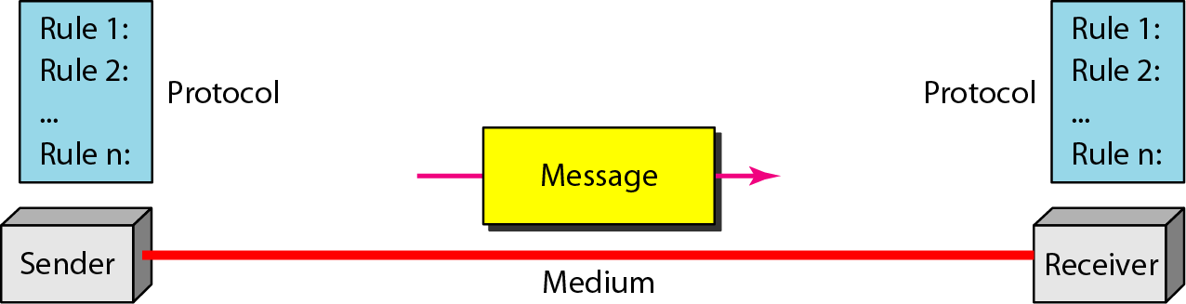
Data Communication Component
The following are the basic components for working a communication system.
Transmitter (Sender),
Receiver,
Medium,
Message, and
Protocol

Slide 7
Data Communication Component (Cont.)
1. Transmitter (Sender): is the device that sends the message.
It can be a computer, workstation, telephone handset, video camera, and so on.
2. Receiver: is the device that receives the message.
It can be a computer, workstation, telephone handset, television, and so on.
3. Medium: The transmission medium is the physical path by which a message travels from sender to receiver.
It can consist of twisted pair wire, coaxial cable, fiber-optic cable, laser or radio waves (terrestrial or satellite microwave).

Slide 8
Data Communication Component (Cont.)
4. Message: The message is the transmission (data) to be communicated.
It can consist of text, number, pictures, sound, or video or any combination of these.
5. Protocol: A protocol is a set of rules that governs data communication.
It represents an agreement between the communicating devices.
Without a protocol, two devices may be connected but not communicating.
Just as a person speaking German cannot be understood by a person who speaks only Japanese.

Slide 9
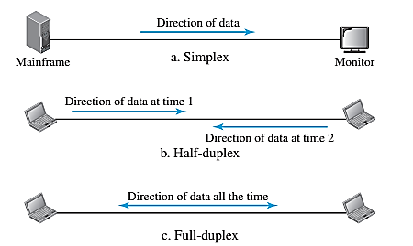
Communication mode
Communication mode refers to the how the data transfer between two devices.
Communication between two devices can be simplex, half-duplex, or full-duplex.

Slide 10
i. Simplex
In this mode the communication is unidirectional, as on a one-way street.
Only one of the two devices on a link can transmit; the other can only receive (see Figure 2 a).
Keyboards and traditional monitors are examples of simplex devices.
The keyboard can only introduce input; the monitor can only accept output.
The simplex mode can use the entire capacity of the channel to send data in one direction.

Slide 11
ii. Half-Duplex
Each station can both transmit and receive, but not at the same time.
When one device is sending, the other can only receive, and vice versa (see Figure 2 b).
The half-duplex mode is like a one-lane road with traffic allowed in both directions. When cars are traveling in one direction, cars going the other way must wait.
The entire capacity of a channel is taken over by whichever of the two devices is transmitting at the time.
Walkie-talkies and CB (citizens band) radios are both half-duplex systems.

Slide 12
iii. Full-Duplex
Both stations can transmit and receive simultaneously.
Is like a two-way street with traffic flowing in both directions at the same time.
Signals going in one direction share the capacity of the link with signals going in the other direction.
This sharing can occur in two ways:
Either the link must contain two physically separate transmission paths, one for sending and the other for receiving;
Or the capacity of the channel is divided between signals traveling in both directions.

Slide 13
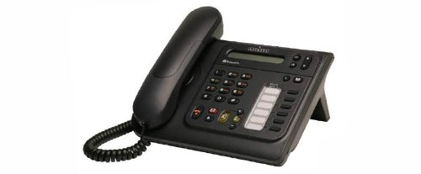
iii. Full-Duplex (Cont.)
One common example of full-duplex communication is the telephone network.
When two people are communicating by a telephone line, both can talk and listen at the same time.

Slide 14
Computer Networks
A computer network is the interconnection of various computer systems located at different places.
In a computer network, two or more computers are linked together with a medium and data communication devices for the purpose of communicating data and sharing resources.
The computer that provides resources to other computers on a network is known as a server.
In the network, the individual computers, which access shared network resources, are known as nodes.

Slide 15
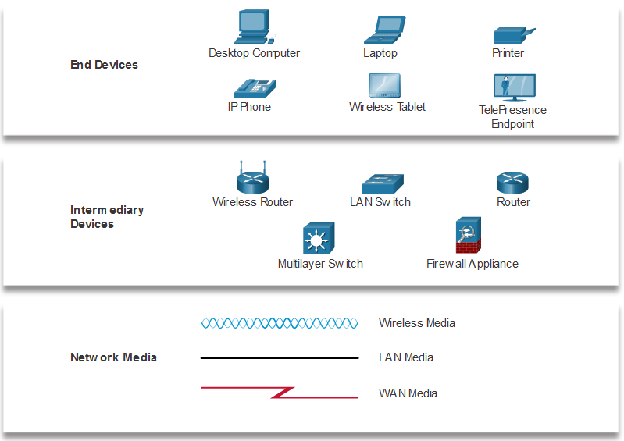
Network Representations
Network diagrams, often called topology diagrams, use symbols to represent devices within the network.
Important terms to know include:
Network Interface Card (NIC)
Physical Port
Interface
Note: Often, the terms port and interface are used interchangeably
Notes:
1 – Networking Today
1.3 – Network Representations and Topologies
1.3.1 – Network Representations

Slide 16
Application of Computer Networks
Some application of computer networks
File sharing
Printer / peripheral sharing
Internet connection sharing
Multi-player games
Notes:
1 – Networking Today
1.3 – Network Representations and Topologies
1.3.1 – Network Representations

Slide 17
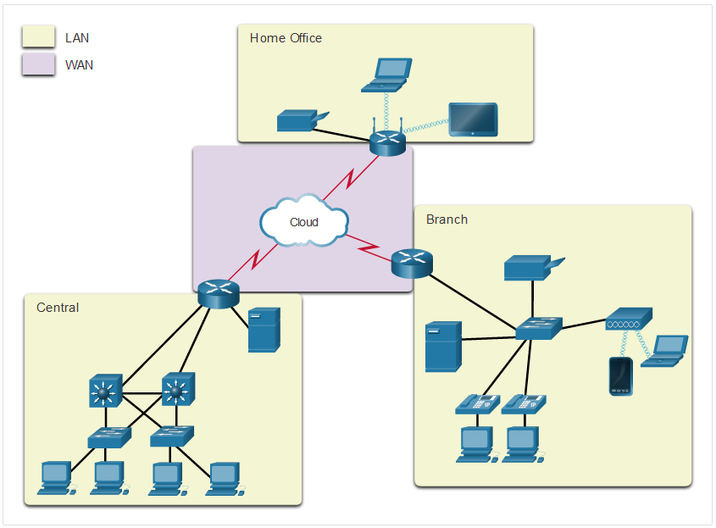
Types of Computer Networks
Network infrastructures vary greatly in terms of:
Size of the area covered
Number of users connected
Number and types of services available
Area of responsibility
From an end user’s point of view there are three basic types:
Local Area Network
Wide Area Network
Metropolitan Area Network
Two most common types of networks:
Local Area Network (LAN) and Wide Area Network (WAN).
Notes:
1 – Networking Today
1.4 – Common Types of Networks
1.4.2 – LANs and WANs

Slide 18
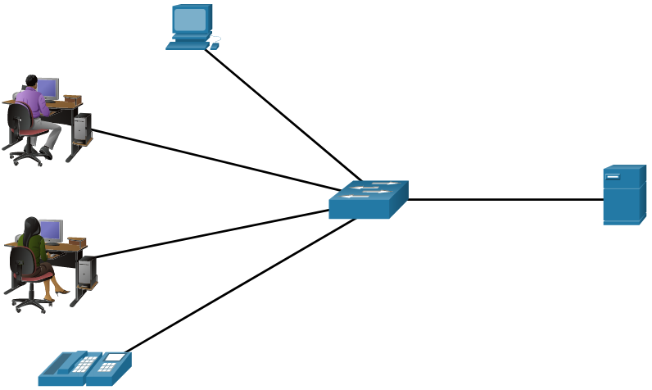
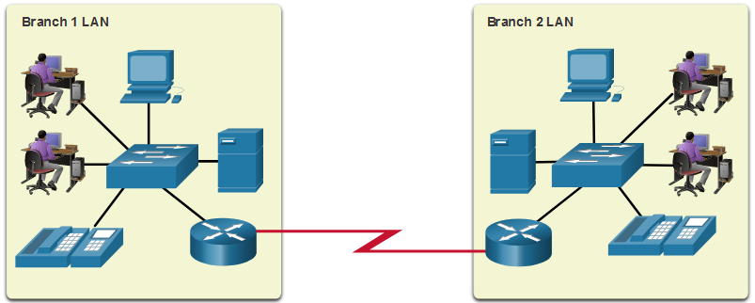
Types of Computer Networks (Cont.)
A LAN is a network infrastructure that spans a small geographical area.
A WAN is a network infrastructure that spans a wide geographical area.
LAN | WAN
Interconnect end devices in a limited area. | Interconnect LANs over wide geographical areas.
Administered by a single organization or individual. | Typically administered by one or more service providers.
Provide high-speed bandwidth to internal devices. | Typically provide slower speed links between LANs.
Notes:
1 – Networking Today
1.4 – Common Types of Networks
1.4.2 – LANs and WANs (cont.)

Slide 19
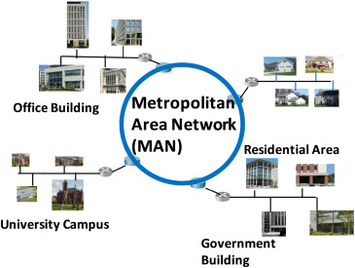
Types of Computer Networks (Cont.)
MAN
It is in between LAN & WAN technology that covers the entire city.
It uses similar technology as LAN.
It can be a single network such as cable TV network, or a measure of connecting a number of LAN’s on a large network s o that resources can be shared LAN to LAN a s well a s device to device.

Slide 20
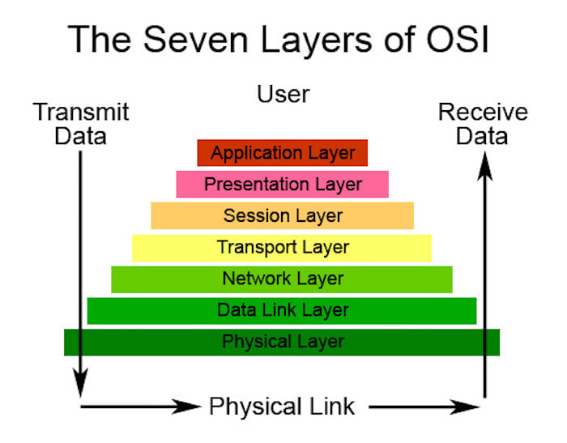
Network Models
The OSI Model
The OSI stands for Open System Interconnection, which was developed in the 1980s.
It is a conceptual model used for network communication.
It is not implemented entirely, but it is still referenced today.
The model consists of seven layers, and each layer is connected to the other.

Slide 21
Network Models (Cont.)
The data moves down the OSI model, and each layer adds additional information.
The data moves down until it reaches the last layer of the OSI model.
When the data is received at the last layer of the OSI model, then the data is transmitted over the network.
Once the data is reached on the other side, then the process will get reversed.
TCP/IP Model
The TCP model stands for Transmission Control Protocol, whereas IP stands for Internet Protocol.
A number of protocols that make the internet possibly comes under the TCP/IP model.

Slide 22
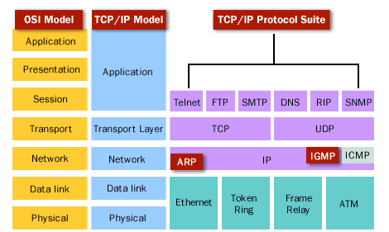
TCP/IP Model (Cont.)
Nowadays, we do not hear the name of the TCP/IP model much, we generally hear the name of the IPv4 or IPv6, but it is still valid.
This model consists of 4 layers. Now, we will look at the diagrammatic representation of the TCP/IP model.

Slide 23
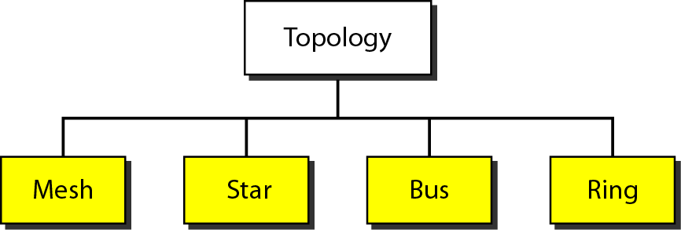
Network Models (Cont.)
Computers in a network have to be connected in some logical manner.
The layout pattern of the interconnections between computers in a network is called Network Topology.
Some of the network topologies is mentioned below.

Slide 24
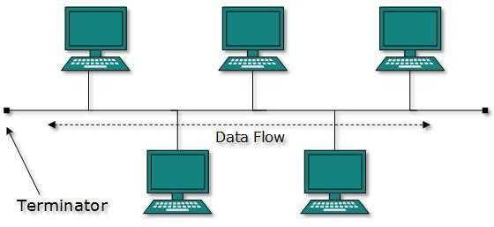
Bus Topology
Uses one main cable to which all nodes are directly connected.
The main cable acts as a backbone for the network.
One of the computers in the network typically acts as the computer server.
It is easy to connect a computer or peripheral device.
The cable requirements are relatively small, resulting in lower costs.
One of the disadvantages is that if the main cable breaks, the entire network goes down.
This type of network is also difficult to troubleshoot.
For these reasons, this type of topology is not used for large networks.

Slide 25
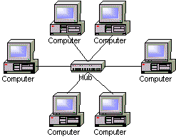
Star Topology
Each computer is connected to a central hub using a point-to-point connection.
The central hub can be a computer server that manages the network.
It is very popular because the startup costs are low.
It is also easy to add new nodes to the network.
The network is robust in the sense that if one connection between a computer and the hub fails, the other connections remain intact.
If the central hub fails, however, the entire network goes down.
It also requires more cable than bus topology and is, therefore, more expensive.

Slide 26
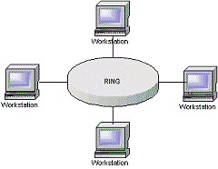
Ring Topology
The computers in the network are connected in a circular fashion, and the data travels in one direction.
This type of network is easy to install and manage.
If there is a problem in the network, it is easy to pinpoint which connection is defective.
It is also good for handling high-volume traffic over long distances since every computer can act as a booster of the signal.
On the downside, adding computers to this type of network is more cumbersome, and if one single computer fails, the entire network goes down.

Slide 27
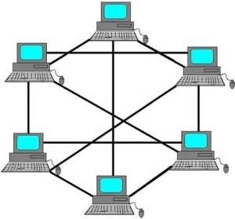
Mesh Topology
In a mesh topology, every node has a direct point-to-point connection to every other node.
Because all connections are direct, the network can handle very high-volume traffic.
It is also robust because if one connection fails, the others remain intact.
Security is also high since data travels along a dedicated connection.

Slide 28
Transmission Media
Two main categories:
Guided ― wires, cables
Unguided ― wireless transmission, e.g. radio, microwave, infrared, sound, sonar
We will concentrate on guided media here:
Twisted-Pair cables:
Unshielded Twisted-Pair (UTP) cables
Shielded Twisted-Pair (STP) cables
Coaxial cables
Fiber-optic cables

Slide 29
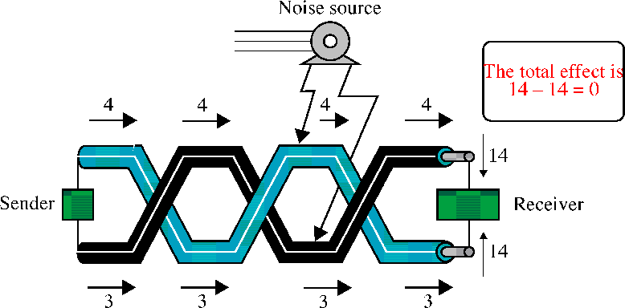
Transmission Media (Cont.)
Twisted-Pair Cables
If the pair of wires are not twisted, electromagnetic noises from, e.g., motors, will affect the closer wire more than the further one, thereby causing errors

Slide 30
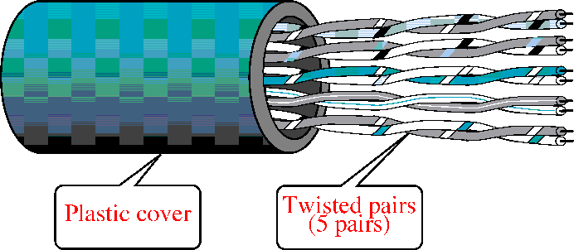
Transmission Media (cont.)
Unshielded Twisted-Pair (UTP)
Typically wrapped inside a plastic cover (for mechanical protection)
A sample UTP cable with 5 unshielded twisted pairs of wires
Insulator
Metal

Slide 31
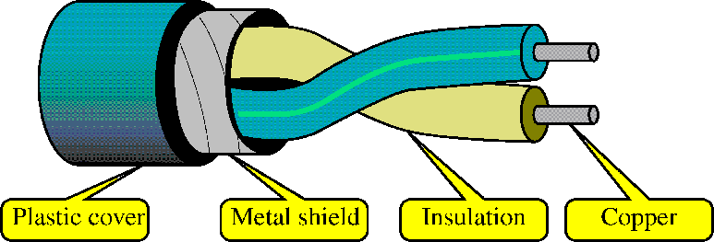
Transmission Media (Cont.)
Shielded Twisted-Pair (STP)
STP cables are similar to UTP cables, except there is a metal foil or braided-metal-mesh cover that encases each pair of insulated wires

Slide 32
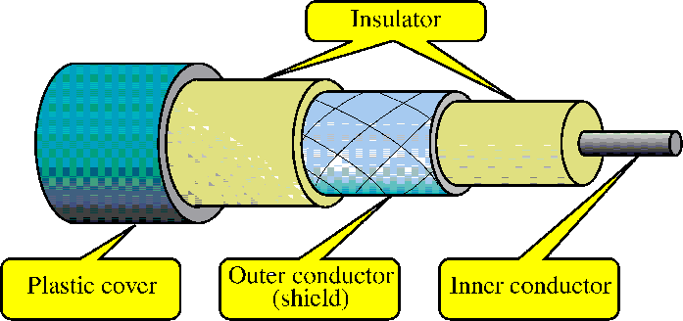
Transmission Media (Cont.)
Coaxial Cables
In general, coaxial cables, or coax, carry signals of higher freq (100KHz–500MHz) than UTP cables
Outer metallic wrapping serves both as a shield against noise and as the second conductor that completes the circuit

Slide 33
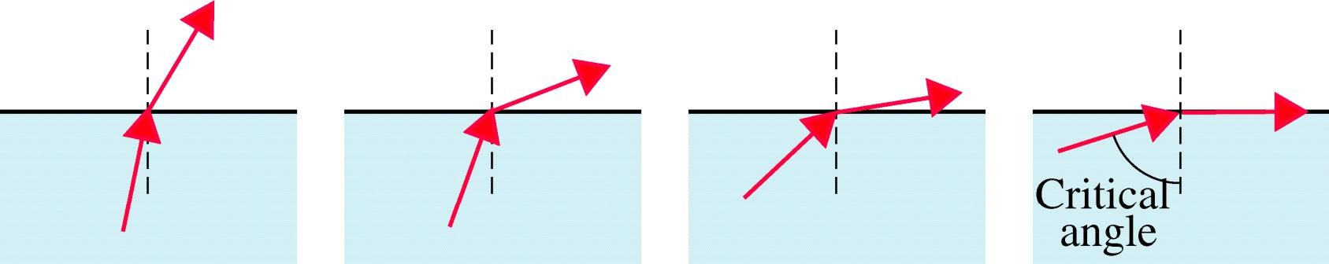
Transmission Media (Cont.)
Fiber-Optic Cables
Light travels at 3x10⁸ ms⁻¹ in free space and is the fastest possible speed in the Universe
Light slows down in denser media, e.g. glass
Refraction occurs at interface, with light bending away
from the normal when it enters a less dense medium
Beyond the critical angle ⇒ total internal reflection

Slide 34
Transmission Media (Cont.)
Fiber-Optic Cables
An optical fiber consists of a core (denser material) and a cladding (less dense material)
Simplest one is a multimode step-index optical fiber
Multimode = multiple paths, whereas step-index = refractive index follows a step-function profile (i.e. an abrupt change of refractive index between the core and the cladding)
Light bounces back and forth along the core
Common light sources: LEDs and lasers

Slide 35
Transmission Media (Cont.)
Fiber-Optic Cables
An optical fiber consists of a core (denser material) and a cladding (less dense material)
Simplest one is a multimode step-index optical fiber
Multimode = multiple paths, whereas step-index = refractive index follows a step-function profile (i.e. an abrupt change of refractive index between the core and the cladding)
Light bounces back and forth along the core
Common light sources: LEDs and lasers

Slide 36
Transmission Media (Cont.)
Unbounded/Unguided Transmission Media
Unguided or wireless media sends the data through the air (or water), which is available to anyone who has a device capable of receiving them.
Types of unguided/ unbounded media are
Radio Transmission
Microwave Transmission

Slide 37
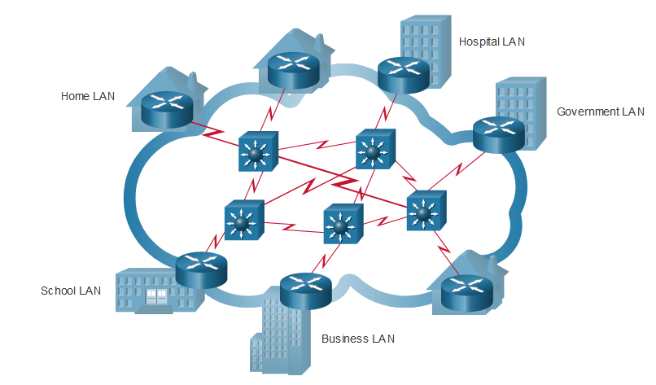
The Internet
The internet is a worldwide collection of interconnected LANs and WANs.
LANs are connected to each other using WANs.
WANs may use copper wires, fiber optic cables, and wireless transmissions.
The internet is not owned by any individual or group.
The following groups were developed to help maintain structure on the internet:
IETF
ICANN
IAB
Notes:
1 – Networking Today
1.4 – Common Types of Networks
1.4.3 – The Internet

Slide 38
The Internet-Based Service
Some of the basic services available to Internet users are −
• Email − a fast, easy, and inexpensive way to communicate with other Internet users around the world.
• Telnet − allows a user to log into a remote computer as though it were a local system.
• FTP − allows a user to transfer virtually every kind of file that can be stored on a computer from one Internet-connected computer to another.
• World Wide Web (WWW) − A hypertext interface to Internet information resources.
Notes:
1 – Networking Today
1.4 – Common Types of Networks
1.4.3 – The Internet

Slide 39
Limitation of Internet
Theft of Personal information
Negative effects on family communication
Internet addiction
Children using the Internet
Virus threat
Spamming
Notes:
1 – Networking Today
1.4 – Common Types of Networks
1.4.3 – The Internet

Slide 40
The Web Concept
Each page available on the website is called a web page.
The first page of any website is called the home page for that site.
What is WWW?
WWW stands for World Wide Web.
A technical definition of the World Wide Web is − All the resources and users on the Internet that are using the Hypertext Transfer Protocol HTTP.
The World Wide Web is a way of exchanging information between computers on the Internet, tying them together into a vast collection of interactive multimedia resources
Notes:
1 – Networking Today
1.4 – Common Types of Networks
1.4.3 – The Internet

Slide 41
The Web Concept (Cont.)
What is HTTP?
HTTP stands for Hypertext Transfer Protocol.
This is the protocol being used to transfer hypertext documents that make the World Wide Web possible.
A standard web address such as Yahoo.com is called a URL and here the prefix HTTP indicates its protocol.
What is a URL?
URL stands for Uniform Resource Locator.
Used to specify addresses on the World Wide Web.
A URL is the fundamental network identification for any resource connected to the web.
Notes:
1 – Networking Today
1.4 – Common Types of Networks
1.4.3 – The Internet

Slide 42
The Web Concept (Cont.)
A URL will have the following format
The protocol specifies how information is transferred from a link.
The protocol used for web resources is HyperText Transfer Protocol (HTTP)
Other protocols compatible with most web browsers include FTP, telnet, newsgroups, and Gopher.
The protocol is followed by a colon, two slashes, and then the domain name.
The domain name is the computer on which the resource is located.
Links to particular files or subdirectories may be further specified after the domain name.
The directory names are separated by single forward slashes.
Notes:
1 – Networking Today
1.4 – Common Types of Networks
1.4.3 – The Internet

Slide 43
The Web Concept (Cont.)
What is a Web Server?
Every Website sits on a computer known as a Web Server.
This server is always connected to the Internet.
Every Web server that is connected to the Internet is given a unique address made up of a series of four numbers between 0 and 256 separated by periods (IP address).
For example, 68.178.157.132 or 68.122.35.127.
What is a Web Browser?
Web Browsers are software installed on your PC.
To access the Web you need web browsers, such as Netscape Navigator, Microsoft Internet Explorer, or Mozilla Firefox.
Notes:
1 – Networking Today
1.4 – Common Types of Networks
1.4.3 – The Internet

Slide 44
The Web Concept (Cont.)
What is SMTP Server?
SMTP stands for Simple Mail Transfer Protocol Server.
This server takes care of delivering emails from one server to another server.
When you send an email to an email address, it is delivered to its recipient by an SMTP Server.
What is ISP?
ISP stands for Internet Service Provider.
They are the companies who provide you service in terms of internet connection to connect to the internet.
You will buy space on a Web Server from any Internet Service Provider.
This space will be used to host your Website.
Notes:
1 – Networking Today
1.4 – Common Types of Networks
1.4.3 – The Internet

